Slide 1
ALL ABOUT ME
By Jamie Goligher
P5/6F

Slide 2
HOW I LOOK
This is a picture of
me on a cruise
I am 9 years old
I have brown hair
I have brown eyes
I am quite small

Slide 3
MY FAMILY
WHERE I LIVE
There are 6 people in my family
I am the the youngest of 4 children
I have 2 big sisters, called Megan and Ceire and 1 big brother called Conor
I have a black and ginger cat called Missy
I live in a small village called Cloughmills, it is about ten miles away from my school
I like where I live but I wish I could live closer to my friends

Slide 4
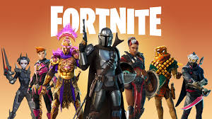
THINGS I LIKE
My favourite food is sausages
My favourite fruit is strawberries
My favourite colour is RED
I really like to play the playstation, my favourite game is Fortnite
I like going to the swimming pool, I can't wait until they open again.
My favourite board game is UNO extreme and I like it when my family plays it with me.

Slide 5
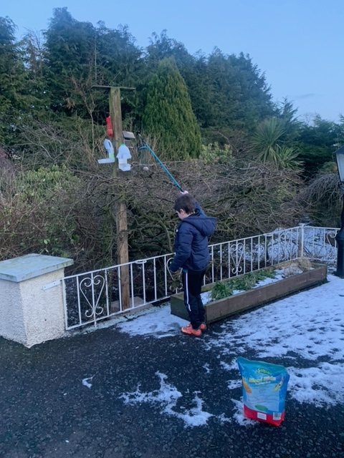
A DAY IN THE LIFE...
Usually I get up and my mum drives me to school, but we do home school now. My mum or sisters help me, but I would rather be in school.
My mum tries to make me read sometimes, my favourite thing to read is the FGTV Journal but I would rather play the PlayStation so I can talk to my friends.
There are bird feeders in my back garden, and it is my job to make sure they are filled.

Slide 6
THIS IS THE END OF THE SLIDESHOW
I hope you enjoyed it!

