Slide 1
Jake McGall
P5/6F Mrs Fulton

Slide 2
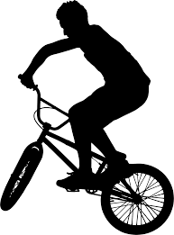
All about me and I like to do to express myself!
I am 9 years old
I like to read my favourite book George’s marvellous medicine.
I love riding my bike and doing stunts
I love playing my switch with all my friends
I cannot wait until summer go to my nanny&pappa’s caravan in Donegal
I have x2 younger brother’s & x2 younger sisters. I love them very much.
I have a large golden retriever dog named Hank. I enjoy taking him on muddy walks and watching him roll in puddles…

Slide 3
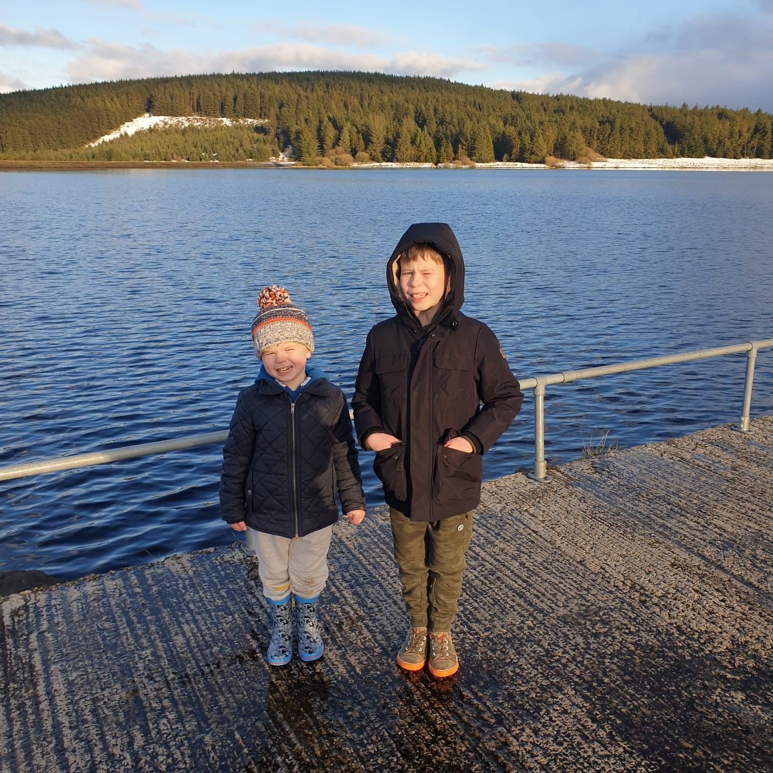
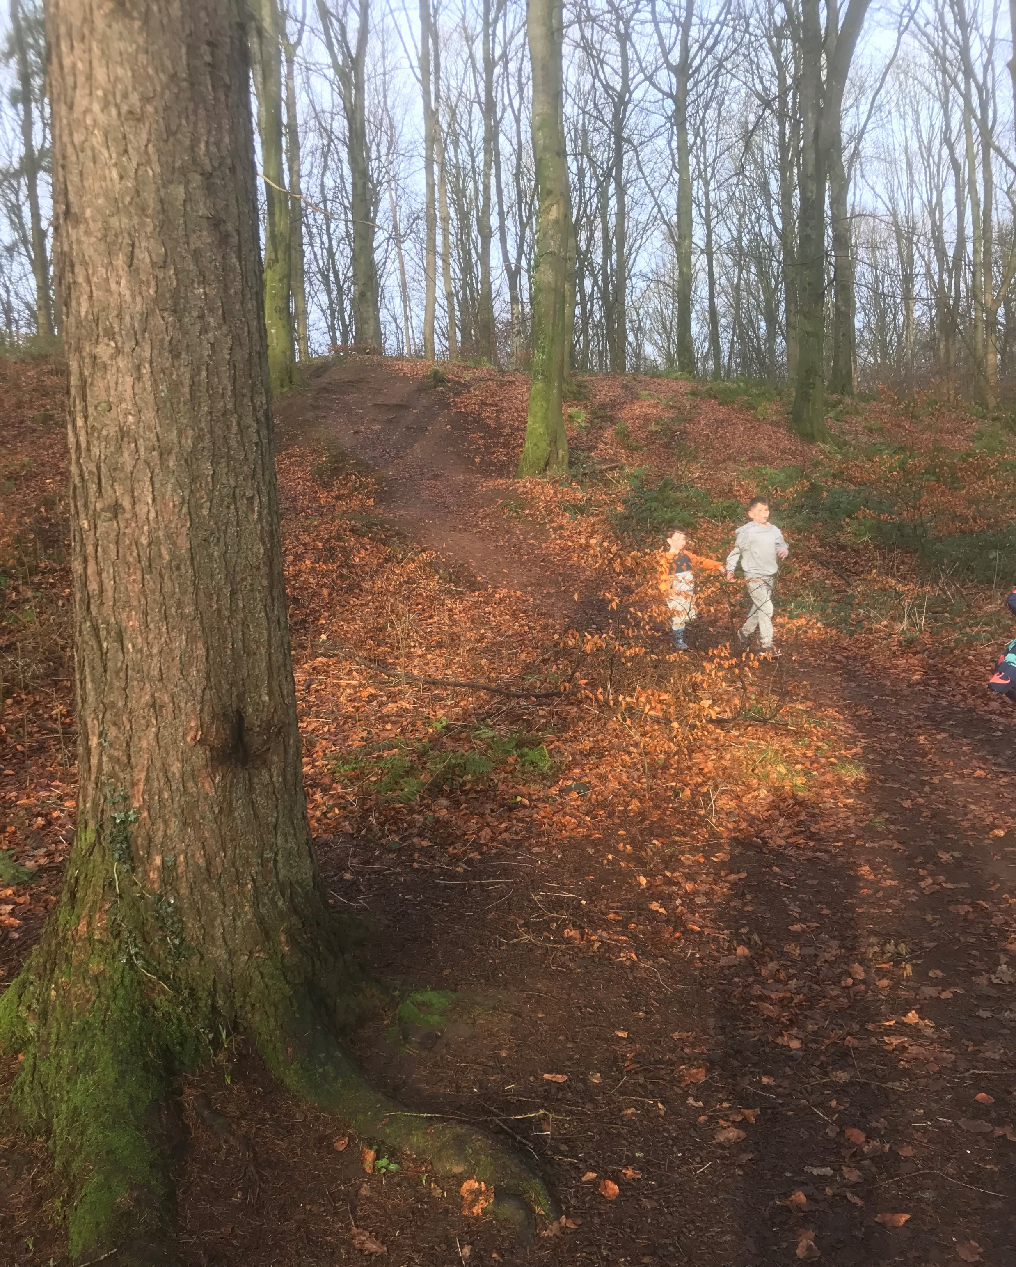
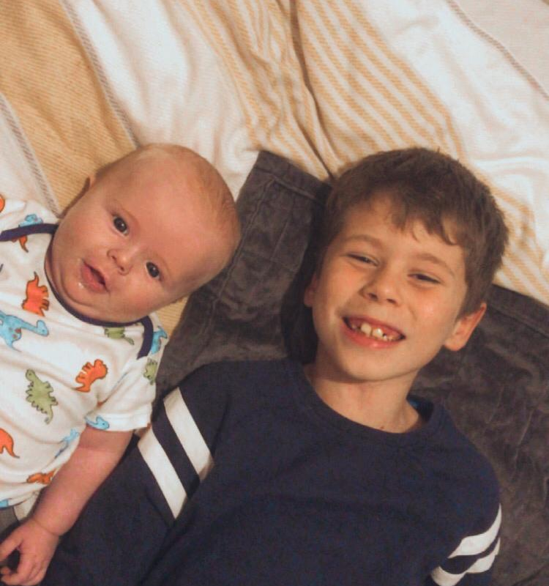
Here is some photos of me spending time with my brothers
Me & Louis just chilling on the bed.
Me & Henry going for a walk in the forest.
Me & Henry going for a chilly walk around a dam.

