Slide 1
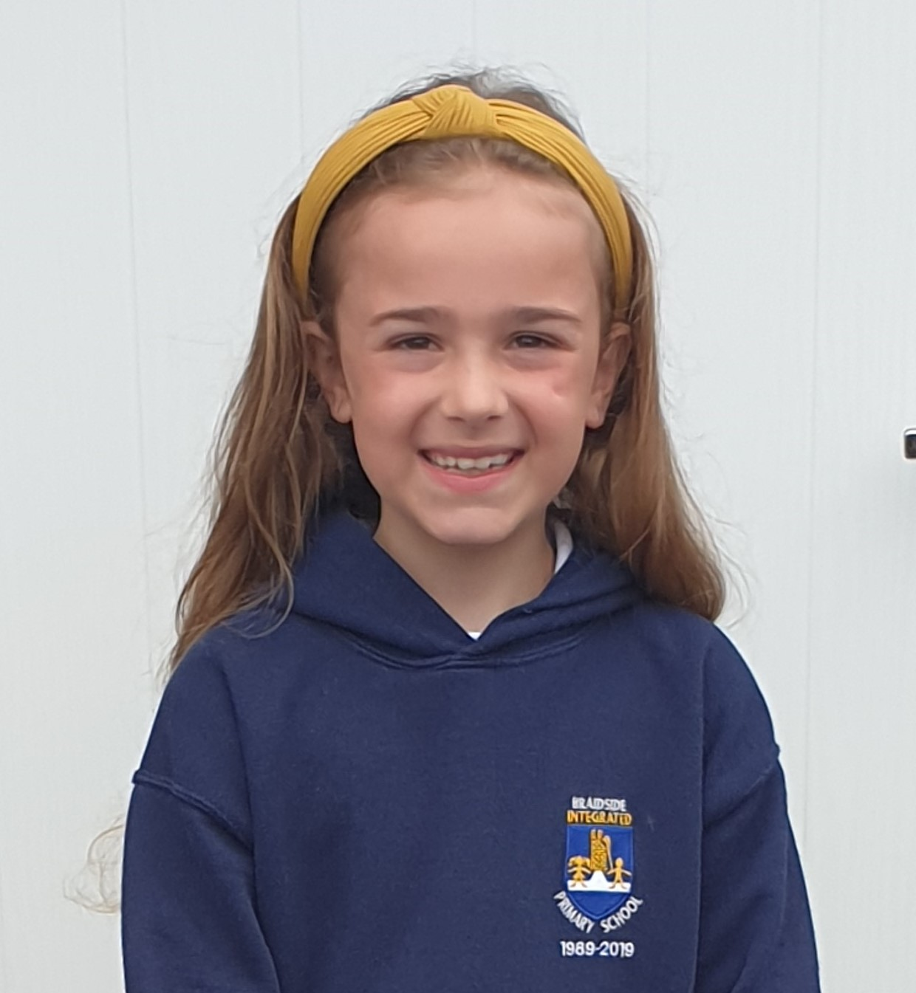
ALL ABOUT ME
Ella Sara Conly P5/6F

Slide 2
Ella Conly
My full name is Ella Sara Conly – Sara is after my great granny!
I was born on the 12th November 2011.
I am nine years old!
I live in Broughshane with my family.

Slide 3
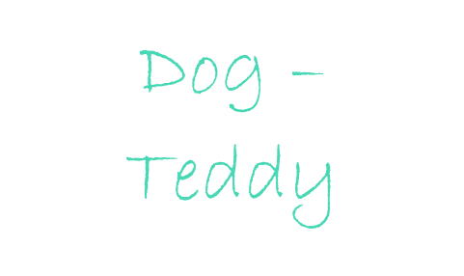
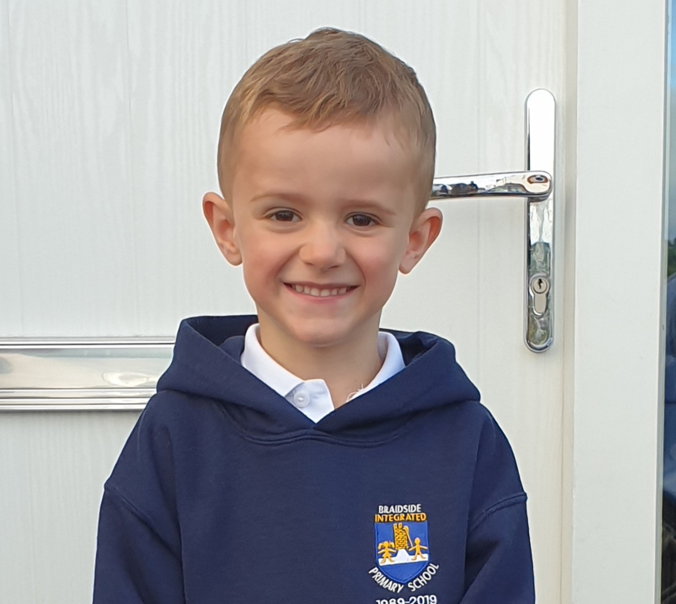
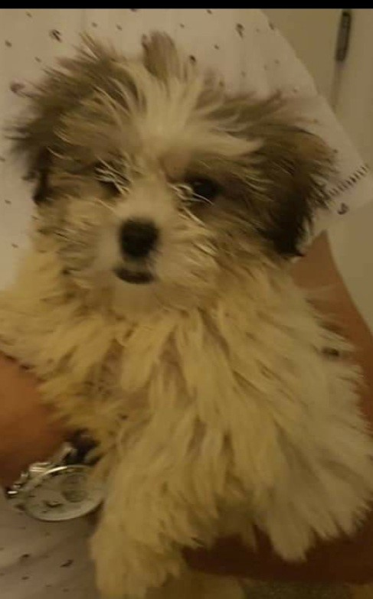
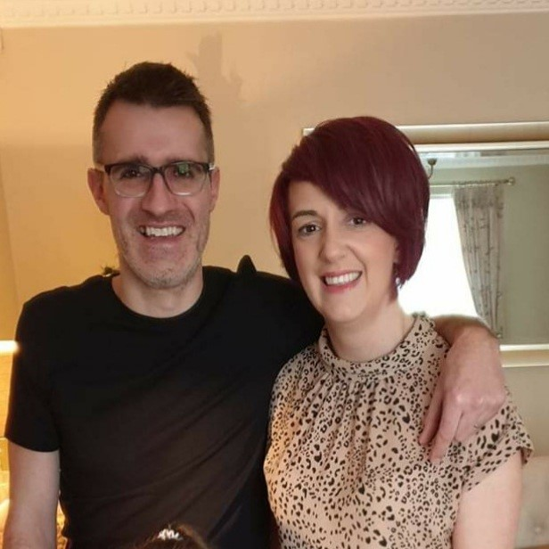
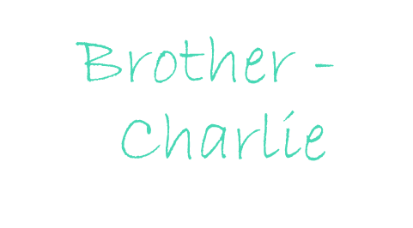
My Family
Mum & Dad
Daddy & Mummy

Slide 4
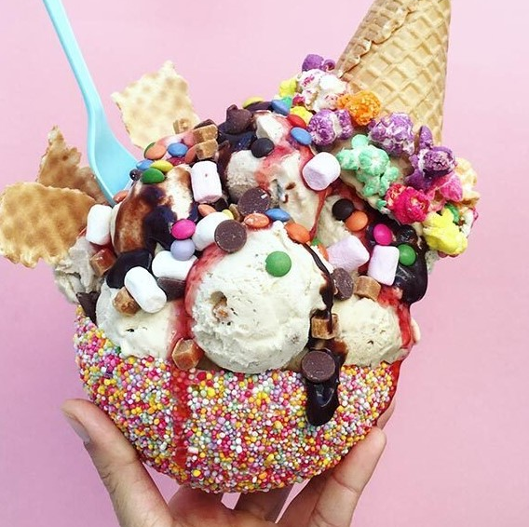
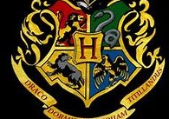
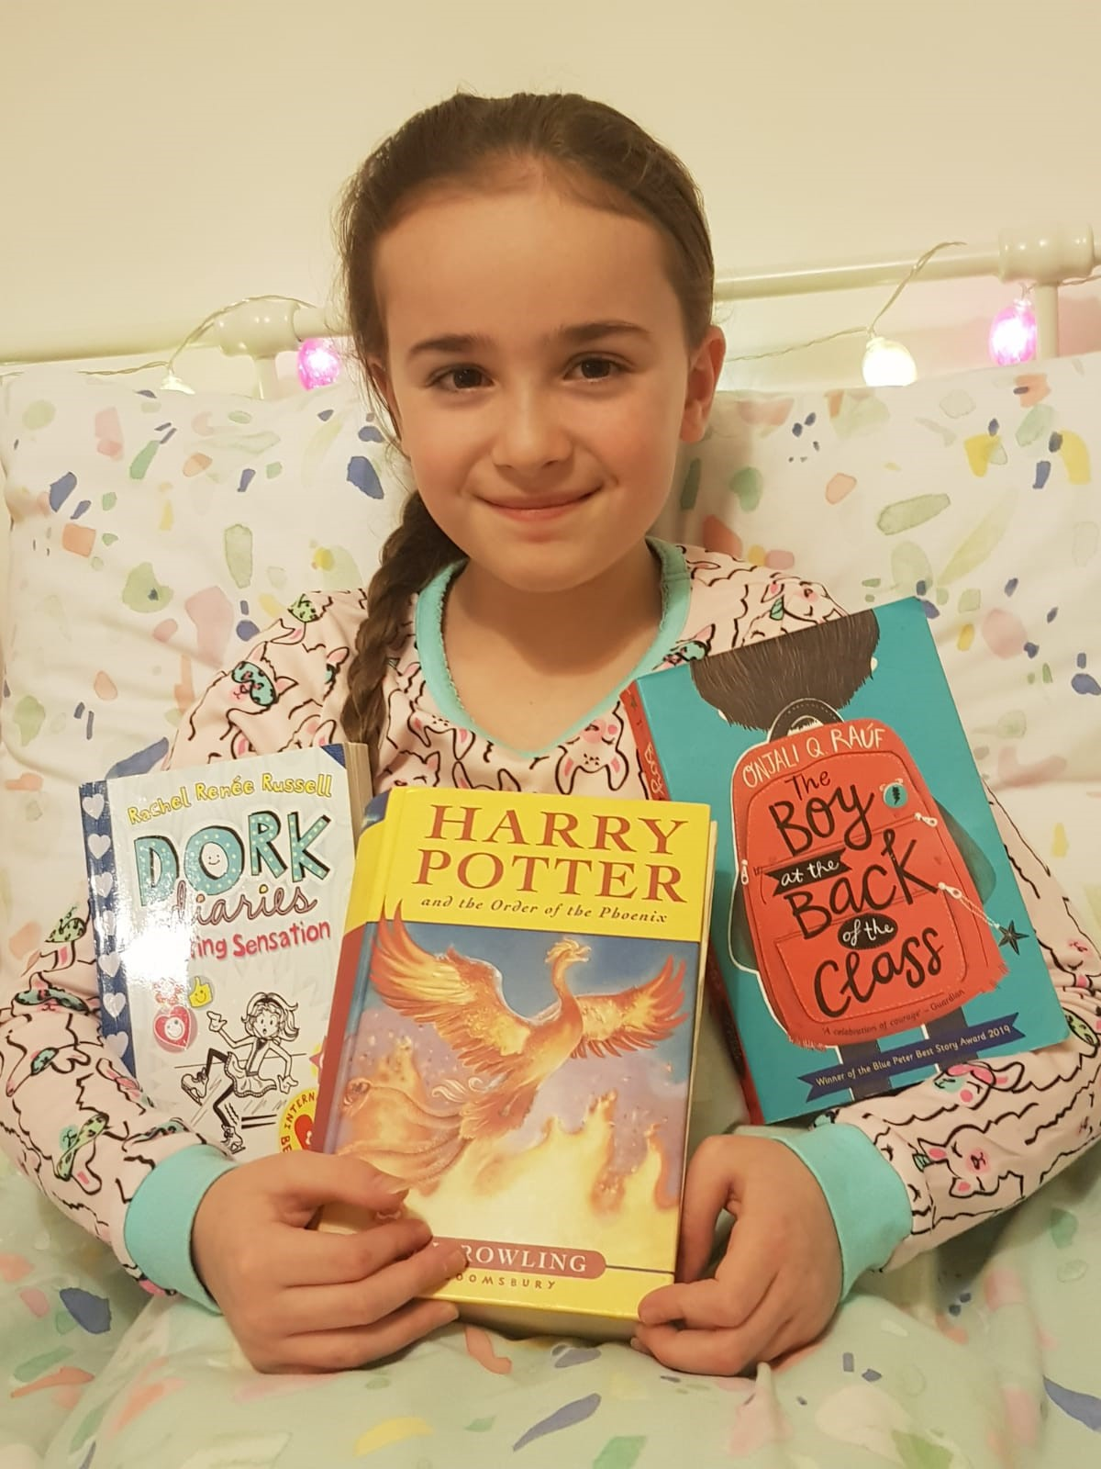
My Likes ☺
Reading
Bodyboarding
Ice-cream
Arts & Crafts
Harry Potter

Slide 5
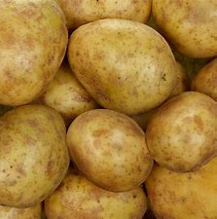
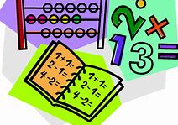
My Dislikes ☹
Potatoes
Numeracy
Animal cruelty
Getting up early!

Slide 6
My Favourites
Colour – Navy
Book – Harry Potter
Food – Yorkshire Puddings
TV Show – The Next Step
Teacher – Mrs Fulton ☺

Slide 7
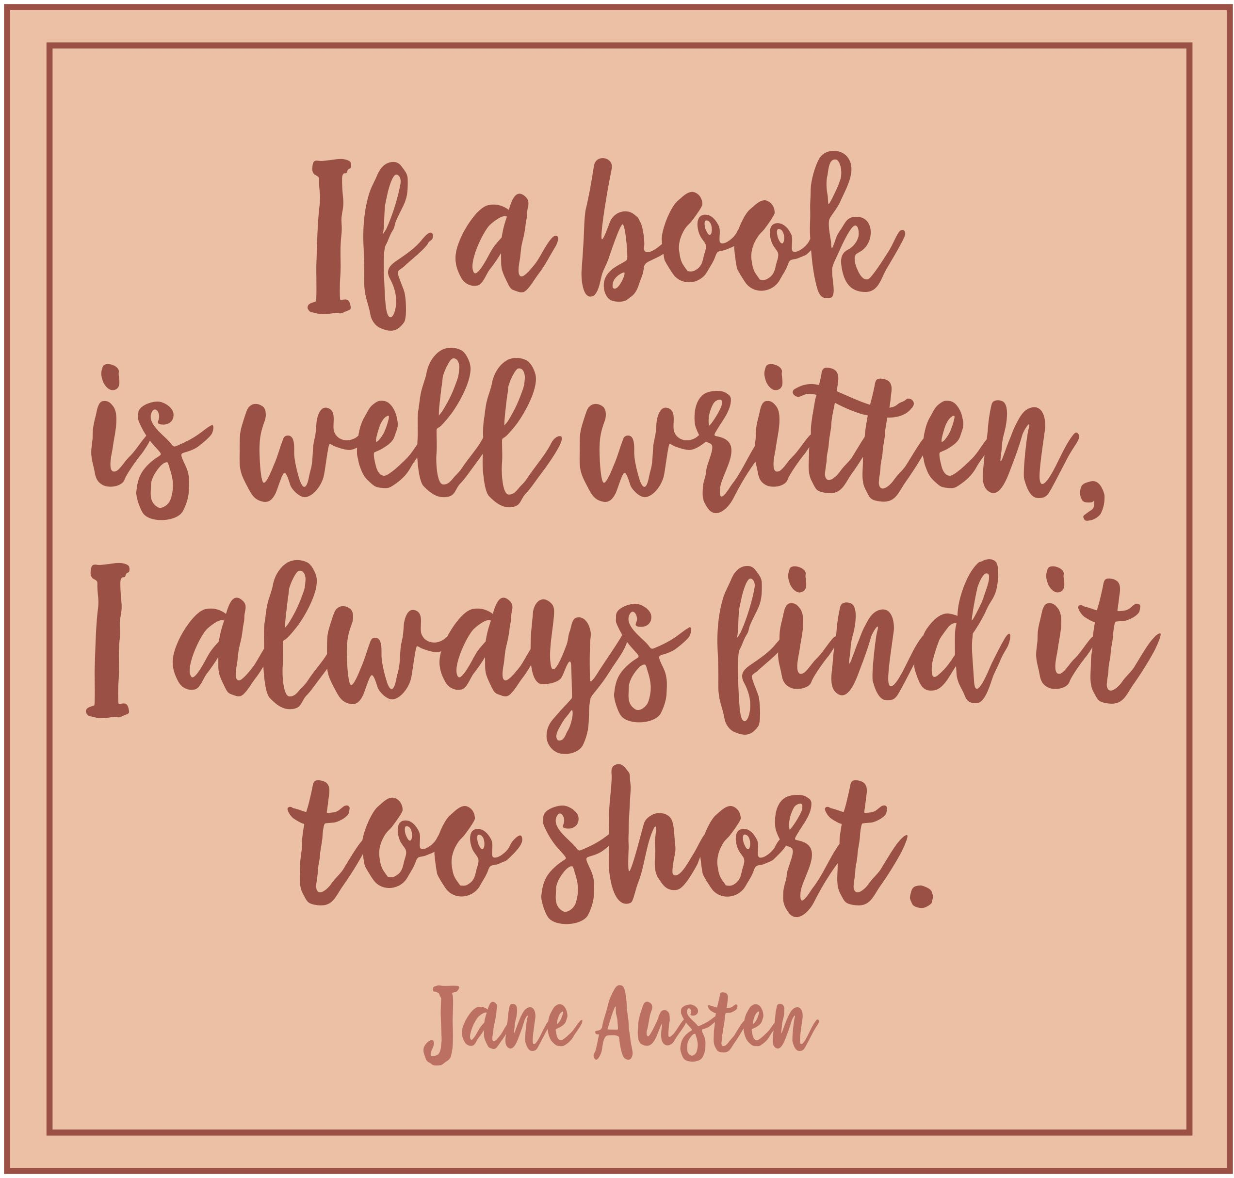
The future …
When I grow up I would LOVE to be an Author!
I love reading and I am inspired, to write my own stories, by my favourite authors – J.K. Rowling, Jacqueline Wilson and Rachel Renee Russell.

Slide 8
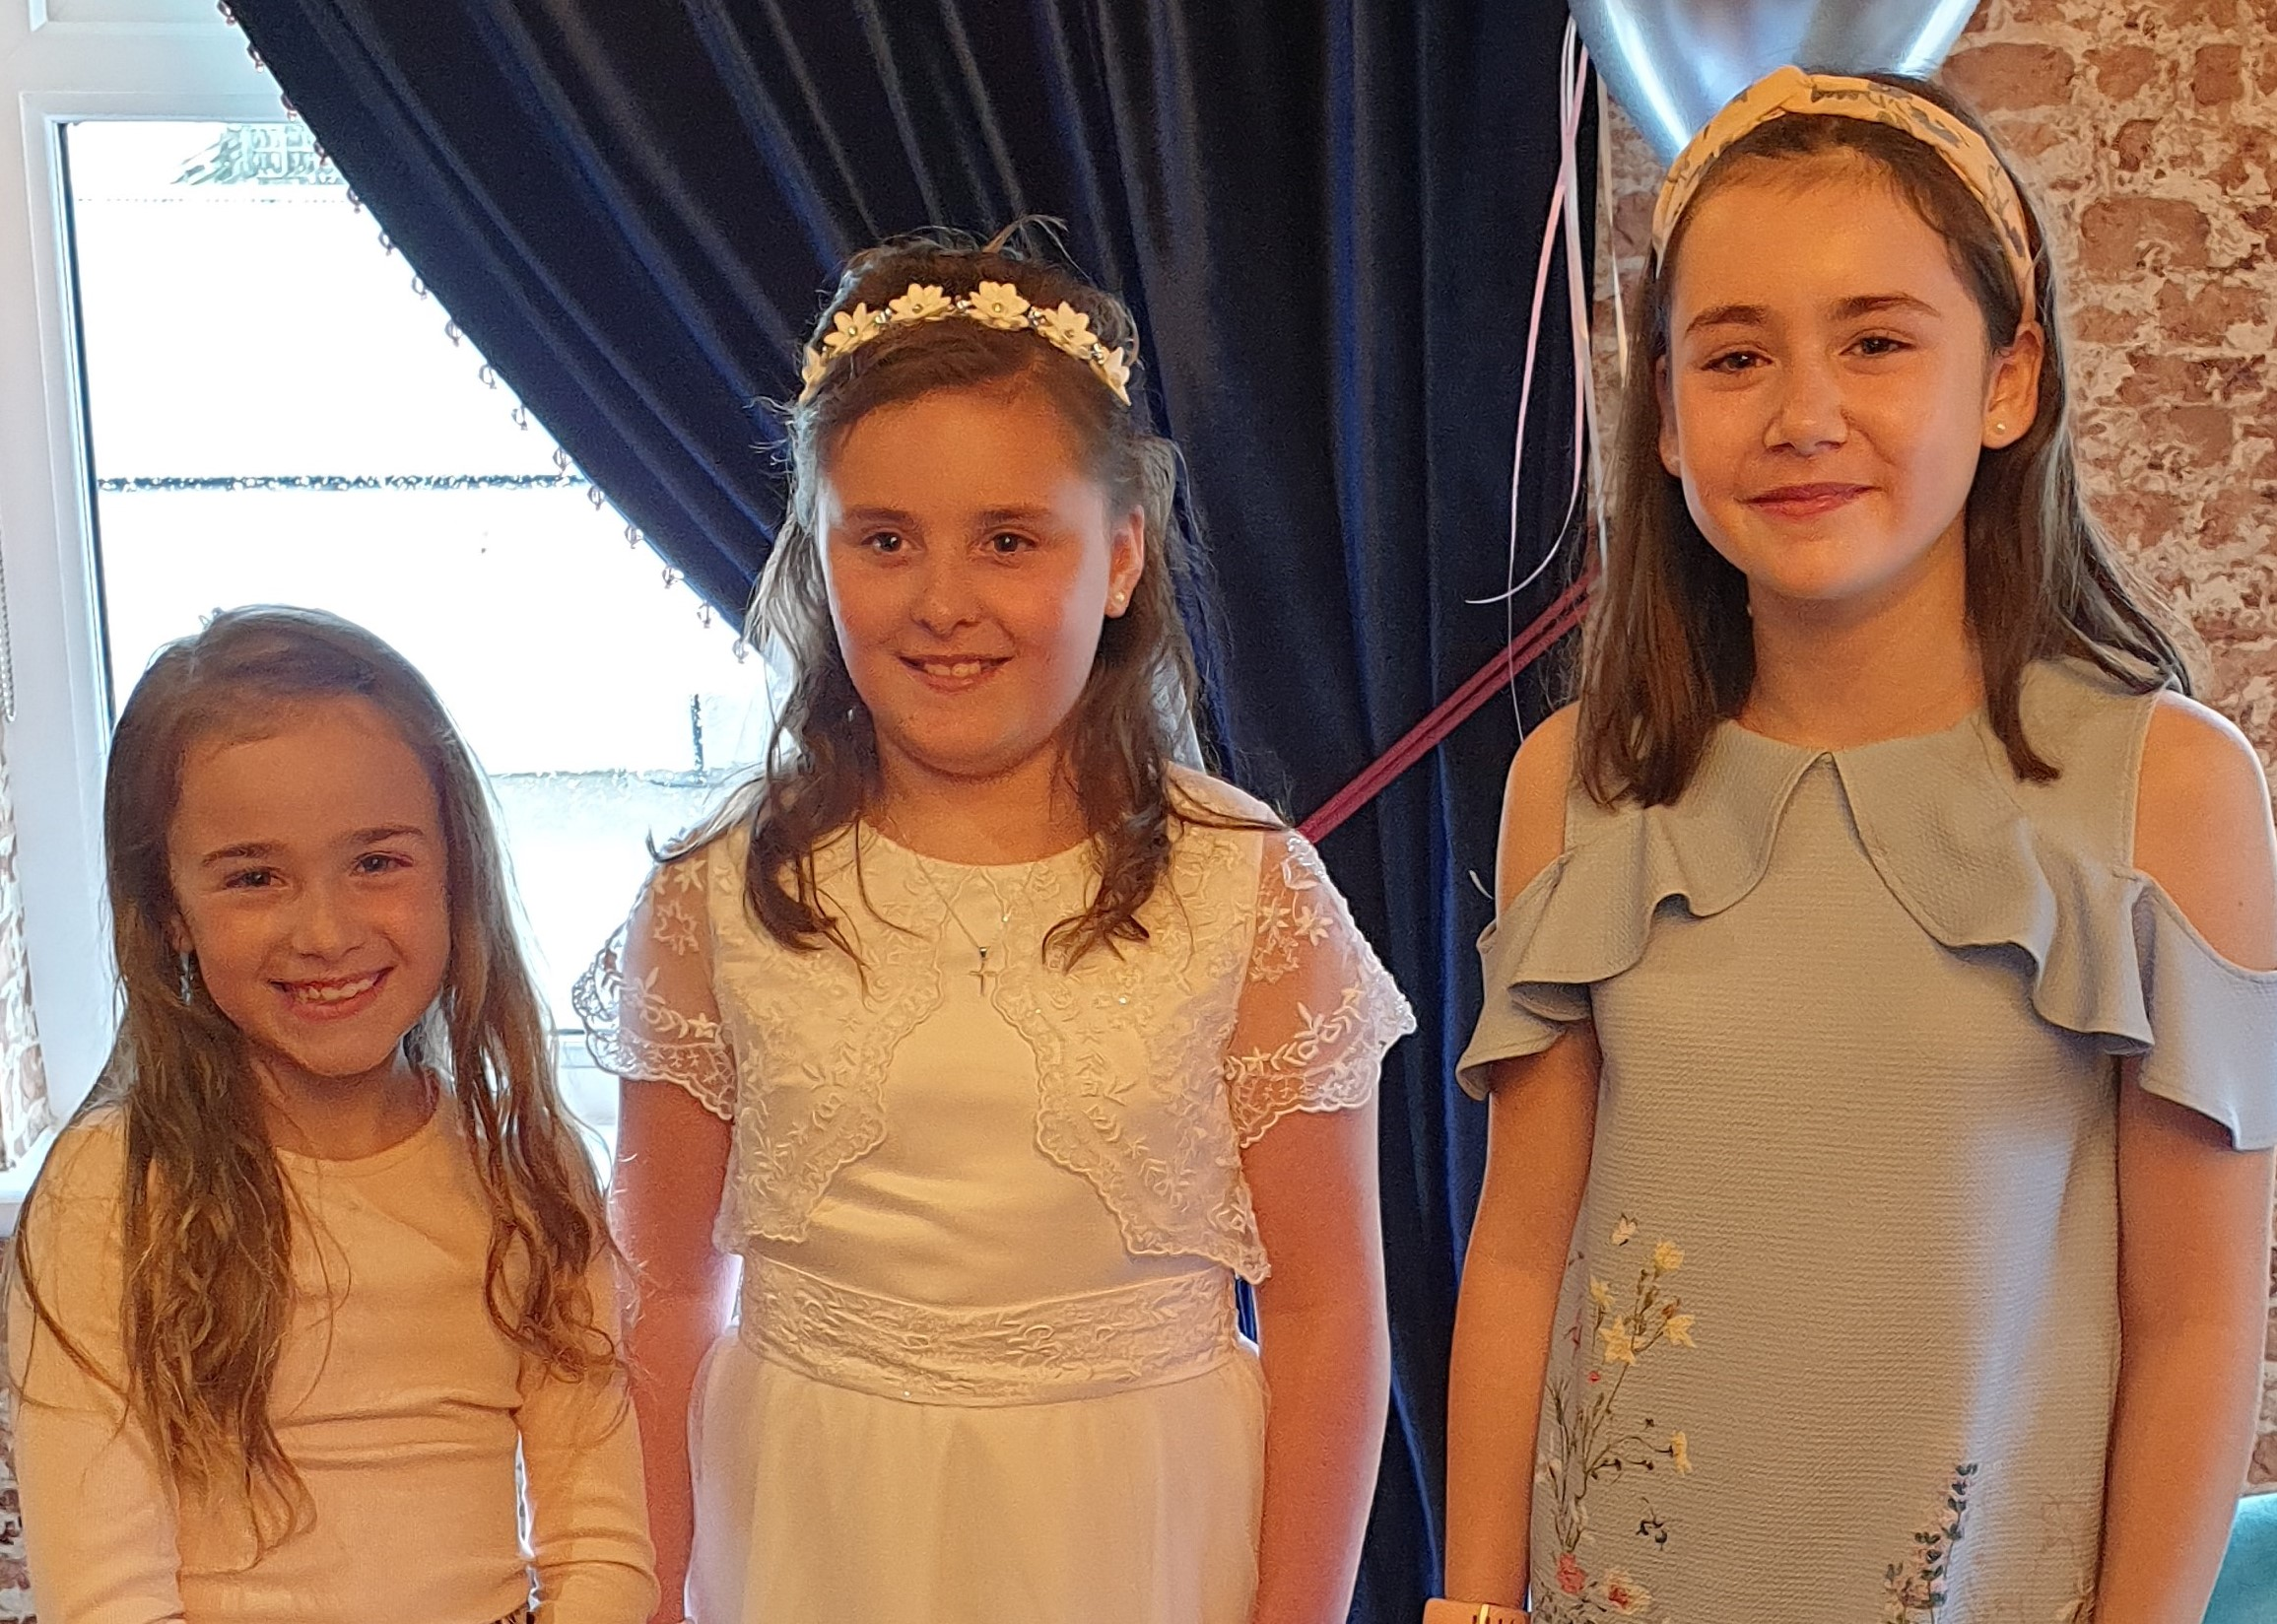
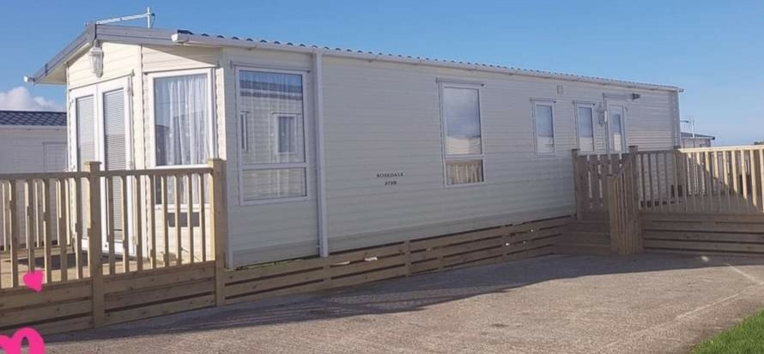
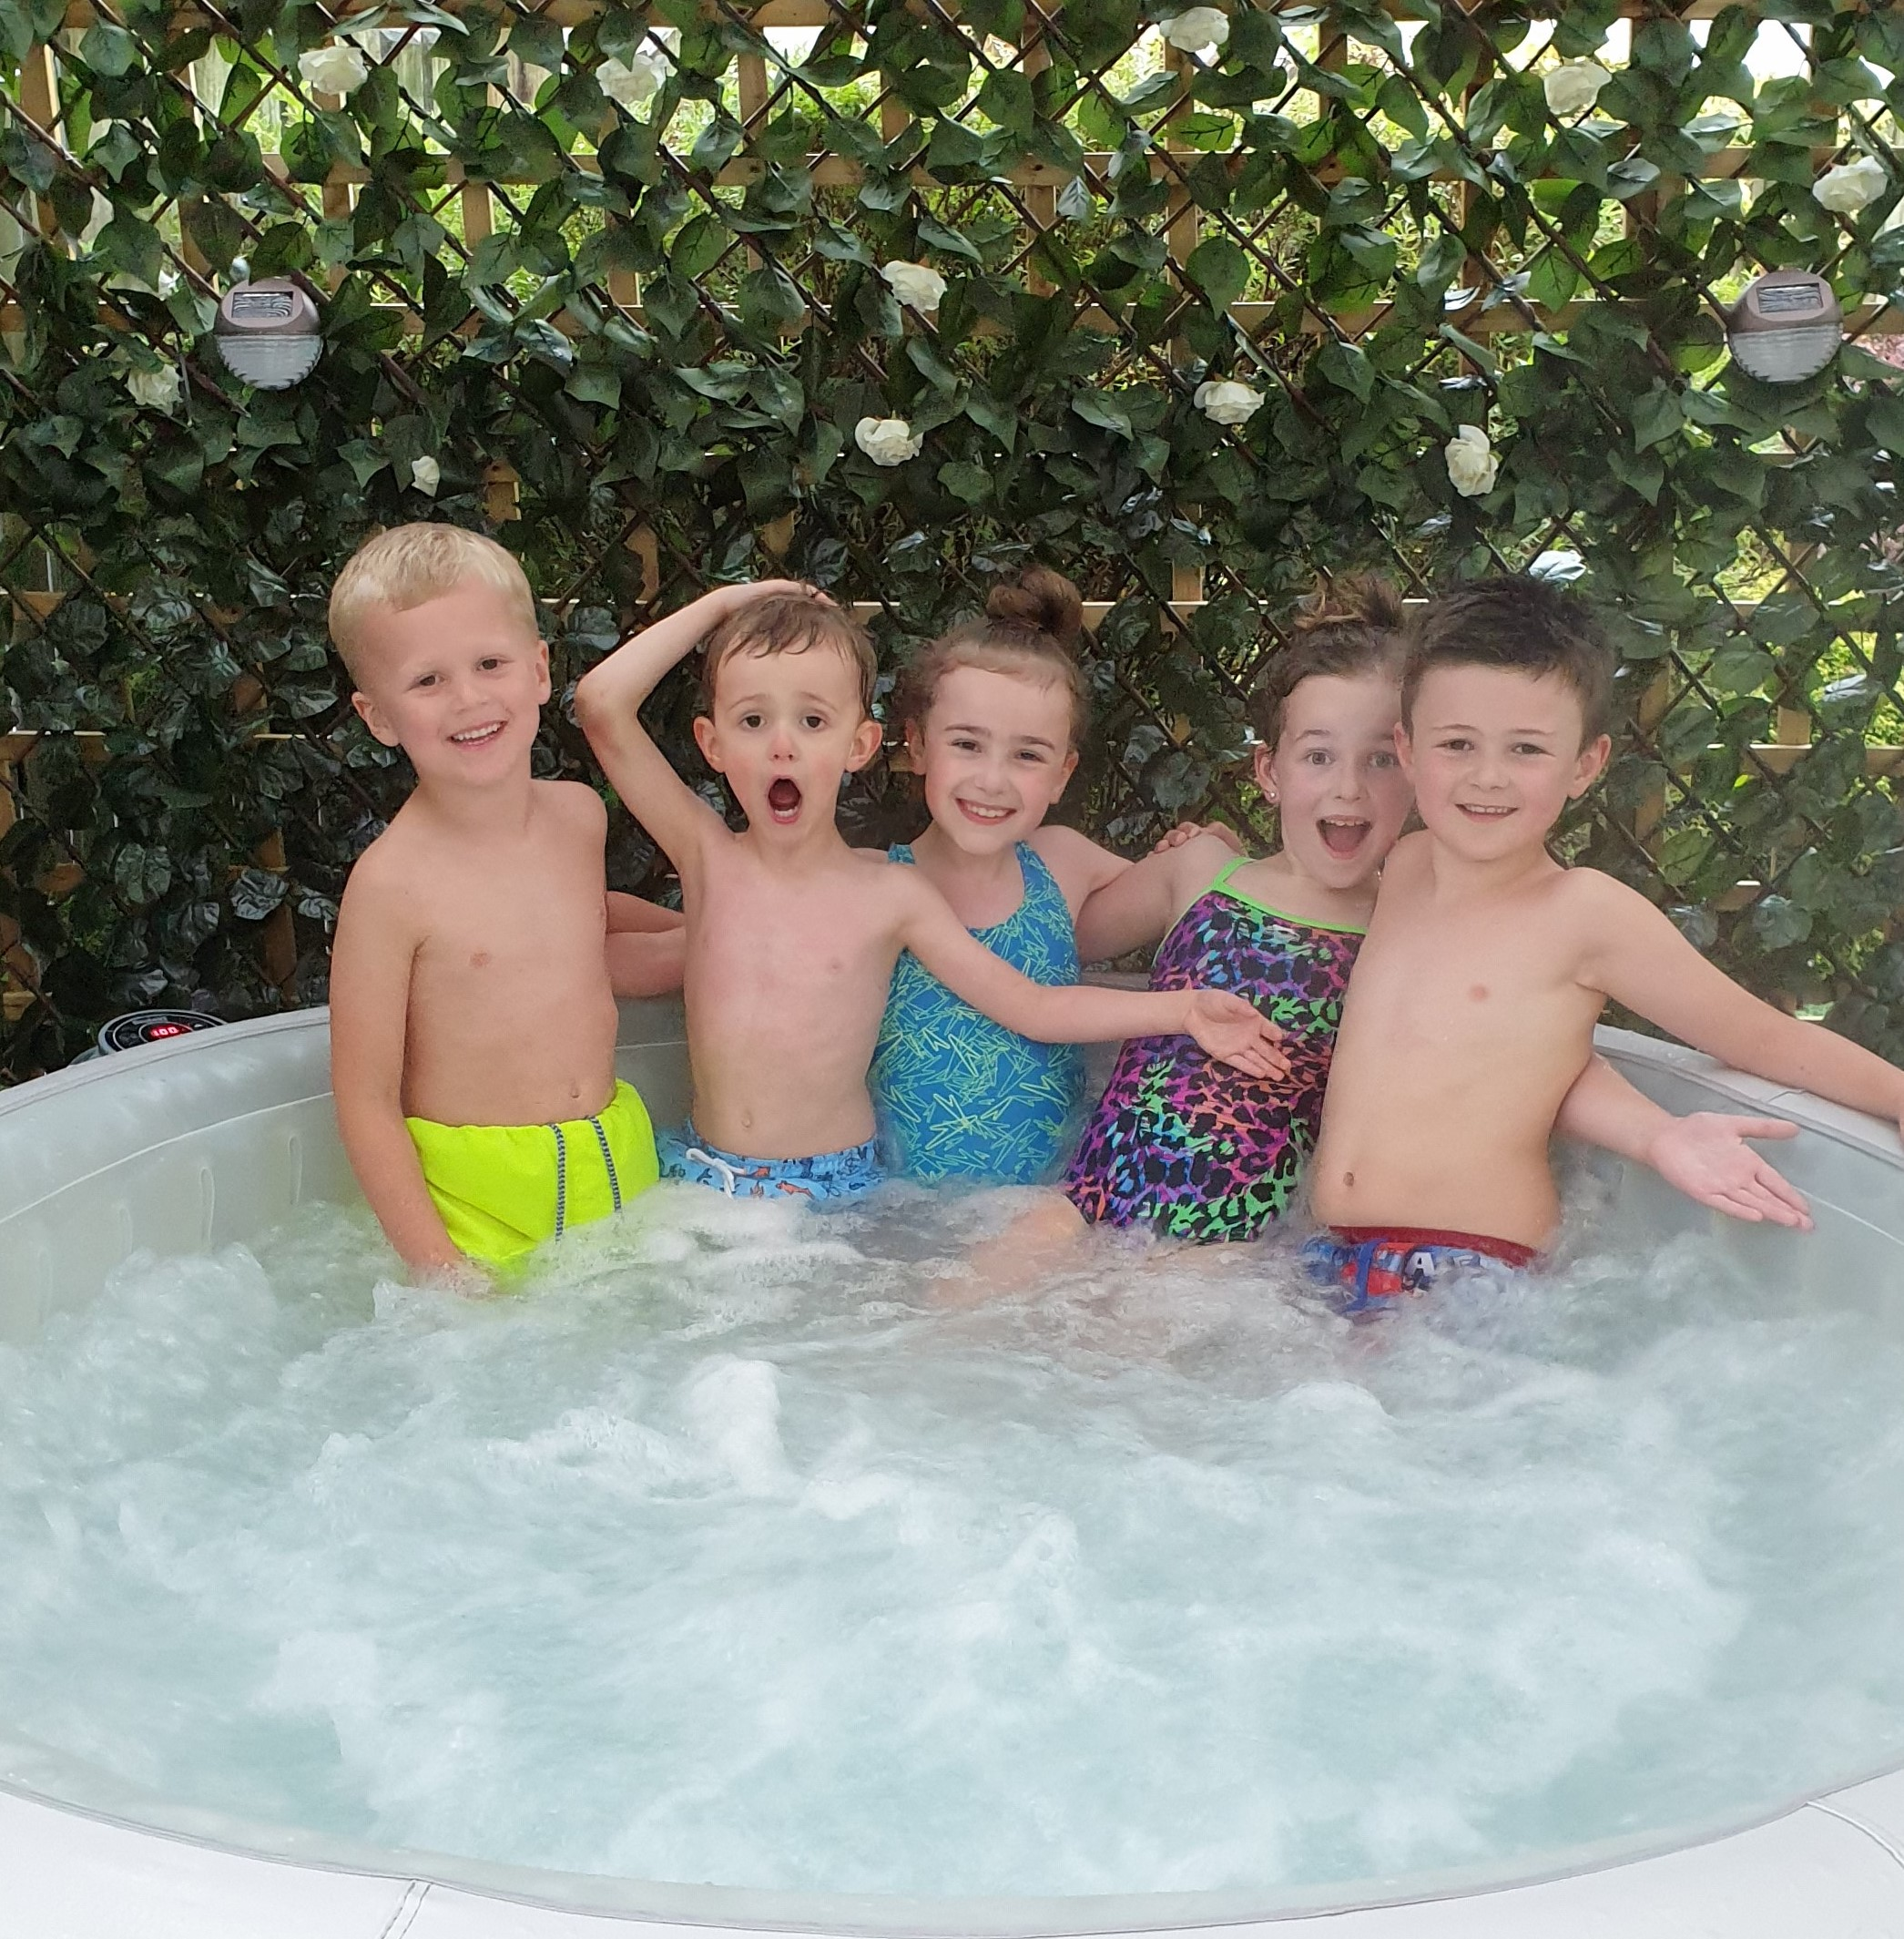
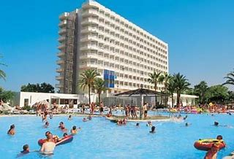
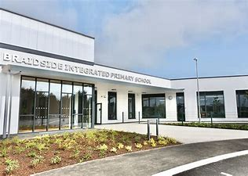
When all this is over, I’m looking forward to …
Family time
Holidays
Play dates
..& so much more!
School

Slide 9
Thanks for watching!
By
Ella Conly
P5/6F

