Slide 1

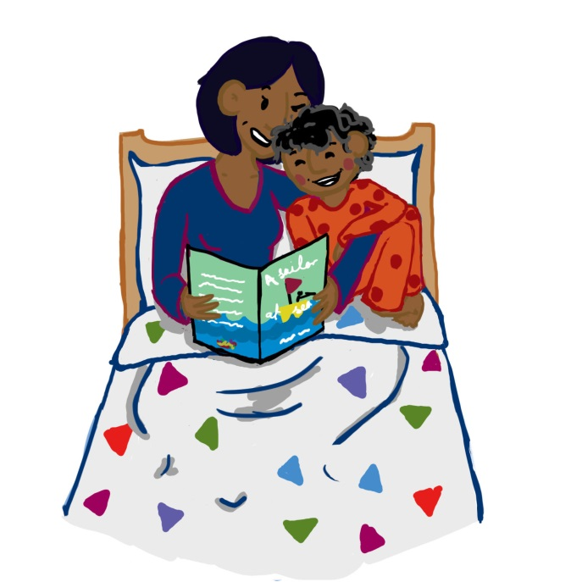
Getting Ready to Learn
Big Bedtime Read - welcome to our remote version powerpoint!
Notes:
If possible, organise an eye-catching display of books which will attract attention. If this can be visible leading up to the first Big Bedtime Read session , it may encourage parents to attend.
Introduce parents to Big Bedtime Read, emphasising the fun it will be for both parent and child! In addition, by spending a short time each night, reading together, a parent I laying the foundation for so many, many important skills.

Slide 2

Big Bedtime Read
Aims of this powerpoint:
To explore the vital role that books, and being read to regularly play in your child’s development
To highlight the importance of parental involvement in reading to their young children and in setting regular bedtime routines
To share ideas about how to enjoy a book with your child
To give further ideas about how to best support your child’s language development
Getting Ready to Learn
Notes:
Outline briefly what you will be focussing on throughout the session /session.

Slide 3

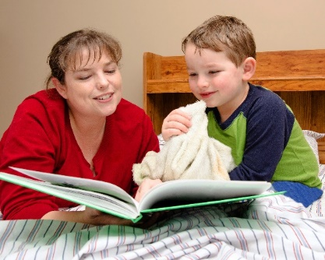

Big Bedtime Read
As a parent you are the most important person in the life and development of your child.
You have a key role to play in preparing them for school by helping to build oral language skills which will help support them in learning to read and write.
One of the best ways you can do this is by simply sharing a book with them.
Yet according to recent research, the proportion of toddlers being read to every day has dropped from 70% to just 50% in the last five years, a decline which poses a significant threat to our children’s language development!
Notes:
By reading a book with your child you stimulate their brain development.
By reading a book with your child you help them develop literacy skills long before they can read and write themselves.
By reading a book with your child you are nurturing their oral language development so they will be ready and willing to learn with their teacher in school.
By reading a book with your child you are being a good role model - showing them that reading is fun, reading is entertainment and reading is for everyone.

Slide 4
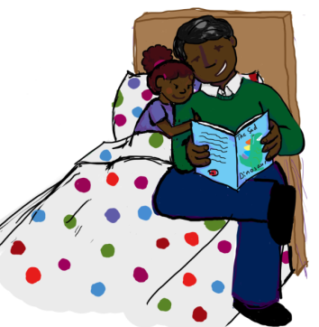
Big Bed Time Read
Adult-child Interactions
As a parent and child snuggle up together and explore other worlds in the pages of a book, they enjoy a special time of parent-child bonding, as they share their thoughts and emotions, and communicate with each other in a special way.
“The quality of parent-child interaction will greatly influence a child’s opportunities to communicate and facilitate their language development.”
Fey, 1986
Getting Ready to Learn
Notes:
Talk about the pleasure experienced by both parent and child as they snuggle up to enjoy some quality time together.
Often books stimulate conversations and encourage children to share their thoughts and feelings.
Remind Parents about the wealth of information that is available in Birth to Five, which they received when their child was born.

Slide 5



Big Bed Time Read
Why are these sharing, bonding
and reading interactions so important?
because language and reading skills are so foundational for all of life
because children learn by imitating - they watch, and listen, and explore

Slide 6
Big Bed Time Read
Sharing a book together:
helps create a love of books and reading - it brings joy!
develops language and communication skills
encourages exploration and sharing of thoughts, ideas, experiences and feelings, and responding to others’
builds up knowledge as children explore new concepts
stimulates imagination and encourages curiosity
helps develop confidence and self-esteem
Getting Ready to Learn
Notes:
Briefly demonstrate each point by using examples from a range of different books.
Give parents time to browse and talk about the books they think their child would choose and why the book would appeal , e.g.
stimulating illustrations that prompt discussion
highly patterned or rhyming texts tat encourage children to join in
familiar events or characters
humour
adventure
coping with emotions

Slide 7

Big Bedtime Read
By reading books with your child, you are modelling and developing the following skills:
their attention and listening skills
their vocabulary
their speech (as you model and encourage correct pronunciation and age-appropriate grammar)
their early reading skills (eg. book-handling, direction of print)
their awareness of print - that squiggles on a page represent words and have meaning
how to read a story with expression and fluency
their understanding of a story
their memory and sequencing skills
their phonological awareness (sounds, rhyme, syllables)
At 18 months of age, an average child has 6-10 words, by aged 2.5, they have 200, and by age 6, they have 14,000! - that means learning 8-9 new words every day!
Please note! Ditching the dummies and sucky bottles/cups will also help dramatically with this!
Notes:
Why are these language skills important? Here is why….
Vocabulary – words are important because they broaden your child’s general knowledge. The more words your child understands the easier it will be for them to make sense of written words on the page.
Understanding a story – when you read a book with your child, as they listen to you, they begin to be able to make connections between the pictures that they are looking at, the words they hear you say and what is happening to them in their own lives. This helps them to move from “the here and now” to being able to look to the future and the past and think what might happen next. It helps them make sense of the world around them.
Sound awareness – your child is now ready to start to become aware that words are made up of sounds. This developing awareness of the sounds of our language will help your child hear, store and remember words that they need not only for speaking but when they start to learn to read and write.
Print awareness – your child’s attention will naturally be drawn to the pictures as these are what they understand at present. By reading books with you they will begin to realise that that the strange marks on the page also have meaning.

Slide 8

Big Bedtime Read
What is the best way to do it?
Let the children choose what they want to read
Reading books often
Repetition, repetition
Asking questions is vital - who, where, when, what happened, why do you think…?
Cuddle up! reading at bedtime is so important!
Again mummy! Again daddy!
Reading the same story over and over is perfectly ok! Just gradually add in different ones as well to mix it up!
Notes:
Letting your child chose which book to read is a good starting point – they are already wanting to know what is going on even before you open the book!
Position – reading a book brings you “closer” to your children – literally. We usually cuddle up or sit side by side, so we are physically close, are still and calm and focusing together on the same page for longer periods of time. This is great practice for being able to sit and listen to their teacher in school.
Reading books often– all the research shows that children who are read to everyday become better readers.
Repetition. Rereading books is important – no doubt your child has a favourite book – so much so that you may be inwardly groaning as they present you with it for the 100th time! But be reassured that by rereading a book your child has many opportunities to think about the story more deeply, to hear, remember, understand and use new words.
What type of questions should you ask your child as you go through the book?- reading a book is as much about is all about the conversations you have with your child as reading the words on the page. In a conversation we takes turns to ask questions and share our thoughts. By asking questions you can highlight the structure of any story - that there is a sequence to a story : a beginning, a middle and an ending
Who questions – draws their attention to the characters in the story e.g. mouse, fox Gruffalo.. (Gruffalo)
Where questions – draws their attention to the setting e.g. a forest (Owl babies)
When questions – draws their attention to time e.g. bedtime (Goodnight Moon)
What happened – draws their attention to the action e.g. the mouse in the Gruffalo trying not to get eaten!
What information does a child need to know to help them understand a word- when your child hears a new word for the first time it helps if you can simply tell them what it means e.g. “the boy whispered” i.e. he used a quiet voice;
ask them to whisper with you; talk about when they whispered e.g. “Remember when we didn’t want granny to hear what the surprise was planned for her birthday we talked in a quiet voice, we whispered.”; and show them what the word relates to in the picture.

Slide 9


Big Bedtime Read
How do you best support their learning?
Look at the pictures! They are there for a reason!
Have fun! - act it out, add funny voices, make it come alive
Expand on what they say
Focus on what they are interested in
Explain any new vocabulary and highlight key words
Explore the story’s structure (eg beginning, middle, end)
Notes:
You draw attention to a word by – use your voice to draw your child’s attention to them e.g. emphasize them, slow down, pause, point to the relevant part of the picture as you say it.
Respond to their interest by – answering their questions; giving them more information; by talking about something that has happened to them that is relevant.
Expand on what they say by- when your child says something about the story you can elaborate on it e.g. (Room on the Broom) Your child points to the frog and says “Look a frog” you reply “”Yes the frog is jumping in the pond”.
Spend time looking at the pictures-
Draw attention to the words – run your finger along under the text as you read.
Have fun – use your face to express your feelings or that of the characters
vary the volume and pitch of voice to add meaning to the action e.g. the mouse when he speaks you speak in a high pitched quiet voice but when the Gruffalo speaks you use a loud, deeper voice.
act out the story
it is ok to change what you say – you don’t have to read every word on the page – it is ok to just talk about the pictures!
wait for your child to say something about the picture or story – let them take the lead.
let your child turn the pages they love to be in control and don’t worry if they keep turning back or forward to their favourite page.

Slide 10
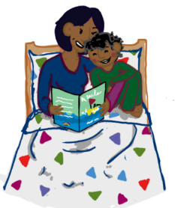



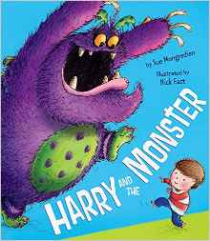


Big Bed Time Read
What kind of books should you read to your child?
Basically any age-appropriate book they are interested in! This might include for example -
Simple Story Books about :
Familiar events
Imaginative worlds
Personal interests
New Experiences
Familiar Tales
Notes:
Show parents/carers the kinds of books that are available and emphasis importance of children making choices.
Talk about how to choose books that will stimulate and encourage participation, perhaps looking at level of difficulty e.g. Level of detail in illustrations and impact on quality of discussion; shorter or longer text depending on listening skills, familiarity of language, experiences and concepts.

Slide 11

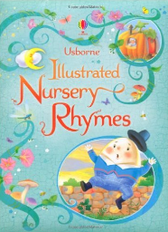
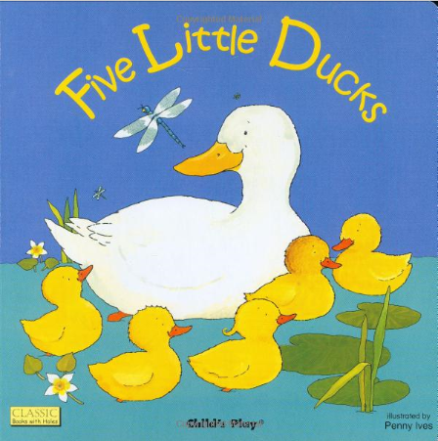
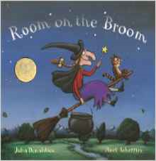
Getting Ready to Learn
Rhyming and Repeat Books
Notes:
Room on the Broom
Giraffes can’t dance
Hairy MaClary
Each peach pear plum
Rhyming text sounds fun!
When you read a rhyming book out loud or say a nursery rhyme we naturally pause before the rhyming word which highlights it to the child and so makes it stand out and become easier to remember.
E.g. Humpty Dumpty sat on a wall
Humpty Dumpty had a great….. fall
Rhyming books are great for helping your child hear that some words sound similar e.g. Room on the Broom.

Slide 12

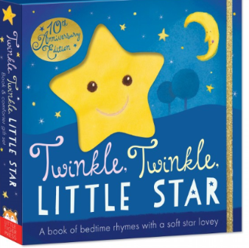

Big Bed Time Read
Nursery Rhymes & Songs
These are especially important as they help to promote -
participation
enjoyment
repetition
rhythm and beat
rhyme
imagination
creativity
Getting Ready to Learn
Notes:
Talk bout the importance of rhymes and songs
Participation - young children can easily join in, or lead, developing confidence, extending vocabulary and speech patterns
Enjoyment – having fun and a sense of achievement, playing with sounds and words
Repetition - a key learning strategy, supporting the development of attention and listening, auditory memory and narrative (sequencing Skills)
Rhythm and beat* - support a range of skills including memory, sequencing, counting, patterning and one-one correspondence, impacting on language and mathematical development as well as music and movement!
Rhyme –recognising similar endings in words, developing phonological awareness
* Beat is the steady pulse that you feel in a rhyme or tune and may clap or tap
feet along to e.g. Clap or tap on the underlined syllables
Hum pty Dum pty sat on the wall
Hum pty Dum pty had a great fall
Rhythm - is the length and accent given to notes or syllables within words
Hum pty Dum pty sat on the wall
Hum pty Dum pty had a great fall

Slide 13
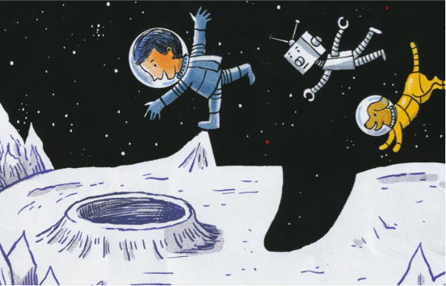



Big Bed Time Read
And don’t forget Information Books
Own life experiences
New worlds
Personal interests
This Photo by Unknown Author is licensed under CC BY-NC-ND
Getting Ready to Learn
Notes:
Information or non-fiction books provide children with a completely different reading experience.
They can share what they already know about a topic and learn new information as they listen to an adult read and study illustrations and photographs.
Demonstrate how information books are laid out differently than fiction books.
The reader can choose to read different sections rather than working from the start to the end of the book!
Children can be encouraged to look for books on topics:
they are already interested in, e.g. animals or vehicles
that link with themes being explored in pre-school e.g. seasons or shapes
that may prepare them for new experiences e.g. trips to the dentist, or a new baby
simply appeal!

Slide 14
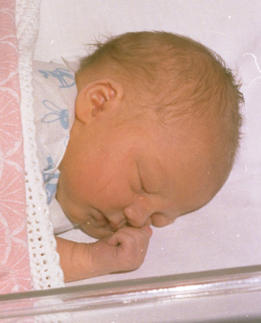

Getting Ready to Learn
You could even make your own homemade books together!
My new little sister!
Notes:
There is nothing more interesting to a child than to see or to hear about themselves and to be able to talk about it with someone else!
Include your child’s favourite things , people, toys, activities and place in their book.
Your child can help you make the book and provide the words – let them become an author themselves! This means that the written words are meaningful to them and also provides you with a good model to expand upon.
Provides a way for them to share their experiences with other people.

Slide 15

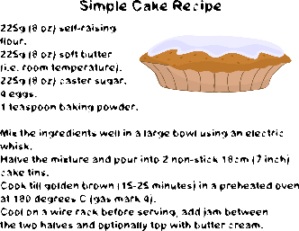




Big Bed Time Read
There are also lots of other opportunities you
can use for reading throughout the day:
1.Environmental print
2.Instructions
(eg recipes)
3.Labels
4.Cards and Letters
5.Posters
6.Websites / Tablets
Getting Ready to Learn
This Photo by Unknown Author is licensed under CC BY
Notes:
Big Bedtime Read focuses on reading for pleasure. However, reading is an important skill that we need to use in our everyday lives.
Explore the wide range of opportunities available to engage children in reading throughout the day, showing them how important it is and encouraging them to use their emerging knowledge of how print works.
Examples might include:
Reading labels and instructions, e.g. cereal packets, cooking instructions, warning signs
Looking up times for T.V. programmes, buses, flights
Identifying places or items e.g. Street names, sign posts, supermarket notices
Cards, flyers and letters
As adults we mostly read silently, in our heads.
Encourage parents to verbalise, pointing to words and reading a loud so that children can begin to make connections and understand more a bout the reading process.
Demonstrate the relationship between reading and writing, so that children begin to understand that print is recorded speech.

Slide 16
Big Bed Time Read
Some added benefits of reading
books is that they can help to -
encourage development of social skills (for example, when moving on to next stages in their development such as potty training or losing teeth; or when facing situations for the first time such as the doctor or dentist)
Getting Ready to Learn

Slide 17
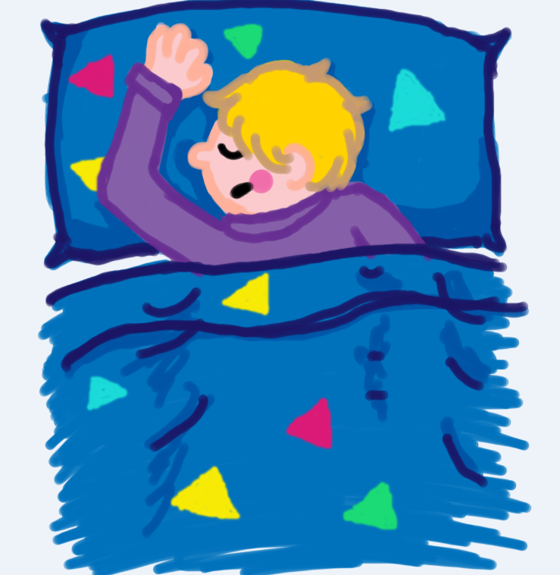
Big Bed Time Read
Bedtime reading can also help to -
develop routines
provide a calm wind-down time → better sleep
Getting Ready to Learn

Slide 18
Big Bed Time Read
We know as adults that a good bedtime routine is vital to promoting good sleep, and the same holds very true for children.
3 - 4 year olds need on average around 12 hours of sleep; but it can range anywhere between 8 and 14 hours a day; and some will still need to have a nap during the day.
Recent research has shown that (ir)regular bedtimes can have a big impact on brain development and behaviour.
Getting Ready to Learn
Notes:
Talk about the impact on children who have insufficient sleep, e.g.
lack of energy to engage in physical activity
lack of concentration affecting communication and learning
irritability –affecting interaction and behaviour
Like charging a battery - the body needs sufficient rest and nourishment, a little charge of the phone may keep it going for a while but it runs out quickly! A child with too little sleep may be up and moving but will not be ‘running at full power!’

Slide 19
Big Bed Time Read
Bedtime Routines
Too much stimulation just before bed can wake your child up again. Instead, spending some time ‘winding down’ and doing some calmer activities, like reading can really help your child get a good night’s sleep.
Make sure your child is calm and ready for bed by having regular routines.
Adapted from Birth to Five Health and Social Care page 89
Getting Ready to Learn
Notes:
Setting routines that ensure children get sufficient sleep is essential.
Sometimes we will be aware that children need to go to bed earlier because they are particularly tired but most nights they should have a clear bed time and know what this means sleep!

Slide 20







Big Bed Time Read
An example of a routine could be:
have a bath
put on your PJs for bed
have supper or a milky drink
brush your teeth
get into bed
share a bedtime story
have a goodnight kiss and a cuddle
Notes:
Talk about other things that might settle a child e.g.
if he of she has a favourite cuddly toy or comfort blanket, make sure it is nearby
leaving a dim light on or the door slightly ajar
Consider controllable background noise levels such a TV volume in other rooms
Discuss the impact of over-stimulating/ distracting environments e.g. etc. TVs/ computers/ tablets in rooms, access to noisy toys
Some parents may have specific concerns about their children’s sleeping patterns.
Reassure parents that it can take patience, consistency and commitment, but most sleep problems can be solved.
There is further information available in the Birth to Five Book (HSC), *page 89-91, providing advice on specific issues, e.g. children who:
will not go to bed
wake during the night
Have nightmares or night terrors
A summary flier is provided on the Getting to Learn website which can be given to those with concerns. If a child’s sleeping continues to be a problem, parents should talk to their health visitor or GP.
*Every parent receives a copy of Birth to Five when their child is born.

Slide 21
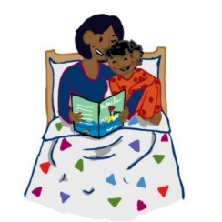
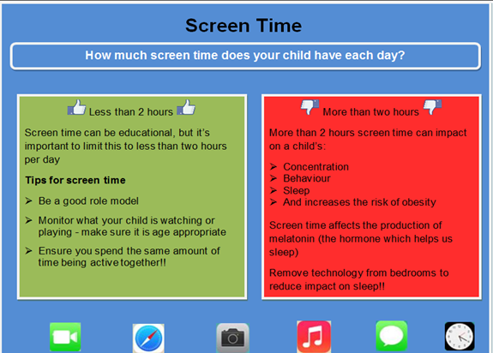
Big Bed Time Read
A word to the wise - what about screens?
Here are some tips from the Public Health Agency
3 + Review Additional Information, Public Health Agency
Notes:
Setting routines that ensure children get sufficient sleep is essential.
Sometimes we will be aware that children need to go to bed earlier because they are particularly tired but most nights they should have a clear bed time and know what this means sleep!

Slide 22


Big Bed Time Read
Research indicates that screen time in the hour
leading up to bedtime can actually hamper sleep.
Use of devices can delay times at which children go to sleep.
Exciting games and lively programmes, or even just short
movies or books can overstimulate the brain and release
hormones that make it more difficult to get to sleep.
The light emitted from screens affects sleep patterns, so even if they are useful in putting us over to sleep, that sleep is not then of a good quality.
So stick with reading the bedtime stories!!☺
Getting Ready to Learn
Notes:
Use of technology is on the increase and is now a big part of our lives! However, it is important to find out more about the impact of technology, particularly the use of screen time, on young children’s sleep.
A review in 2014, (published in the Sleepmedicine Review), found consistent evidence that sleep was hampered by screen time.
Use of devices can delay times at which children go to sleep, providing short amounts of time for actual sleep.
Exciting video games and lively programmes or films engage the brain and release hormones that make it more difficult to sleep.
Light emitted by screen can increase alertness, making it more difficult to sleep.
Use of devices can delay times at which children go to sleep, providing shorter amount of sleep.
The light can disrupt the body’s naturally occurring rhythms, releasing the hormone,melatonin, which helps maintain and regulate sleep-wake cycles.

Slide 23
Keep reading!

