Slide 2

The female ladybird lays its eggs onto a leaf.

Slide 3
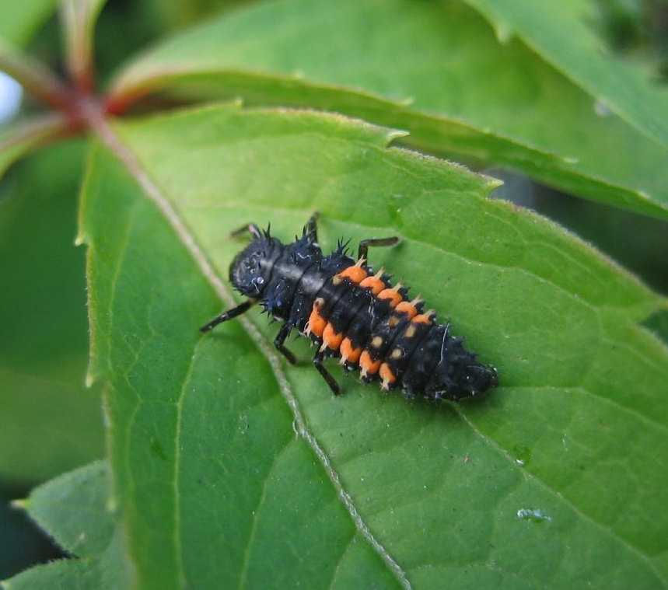
The eggs hatch and the larvae are born. They will spend their time feeding on aphids to grow and be ready for the next stage of life.
Photo courtesy of rjp(@flickr.com) - granted under creative commons licence – attribution

Slide 4
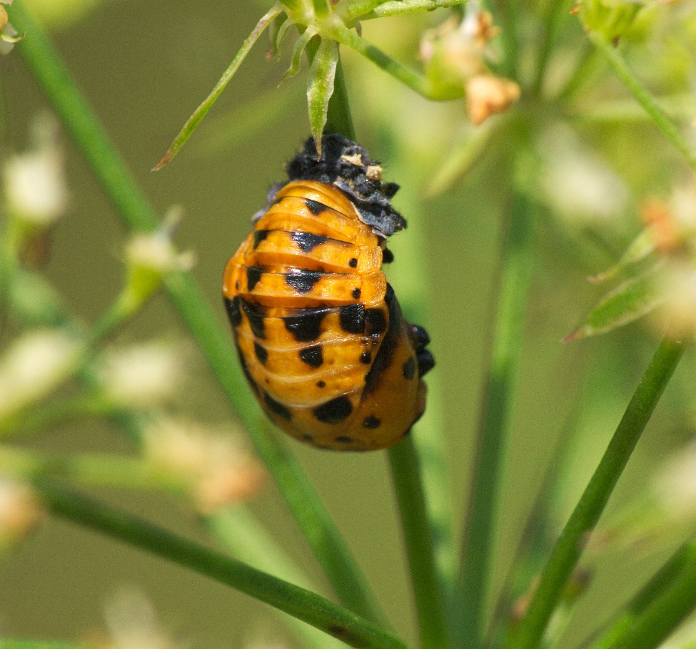
They form ‘pupae’.
This stage lasts 5-7 days.
Photo courtesy of Jonas Myrenas (@flickr.com) - granted under creative commons licence – attribution

Slide 5

An adult ladybird emerges!

Slide 6

Video…

Slide 7


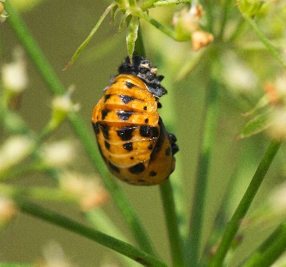

Ladybird Life Cycle

Slide 8

Some Interesting Facts
Some adult ladybirds are known to eat the larvae of other ladybirds when really hungry!
You cannot tell a ladybird’s age from its spots.
Adult ladybirds stay in a dormant state over winter. This is called ‘overwintering’.
Ladybirds will leak a nasty yellow liquid from their knees when threatened. It is called hemolymph and it is poisonous!

